Slide 1
Sublime Text
Create HTML and CSS Files

Slide 2
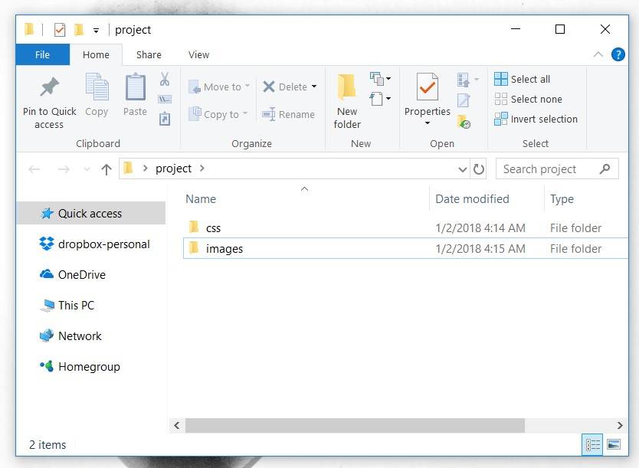
First create a folder project and 2 sub-folders named css and images.

Slide 3
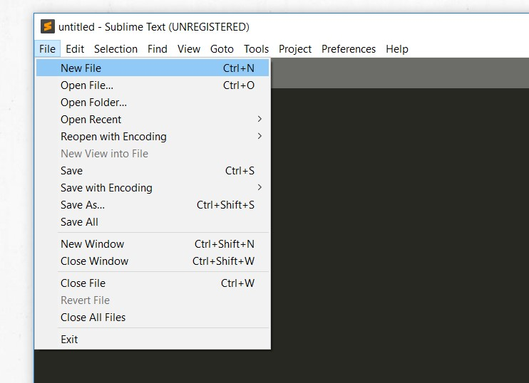
Subsequently, open sublime text and click on New File.

Slide 4
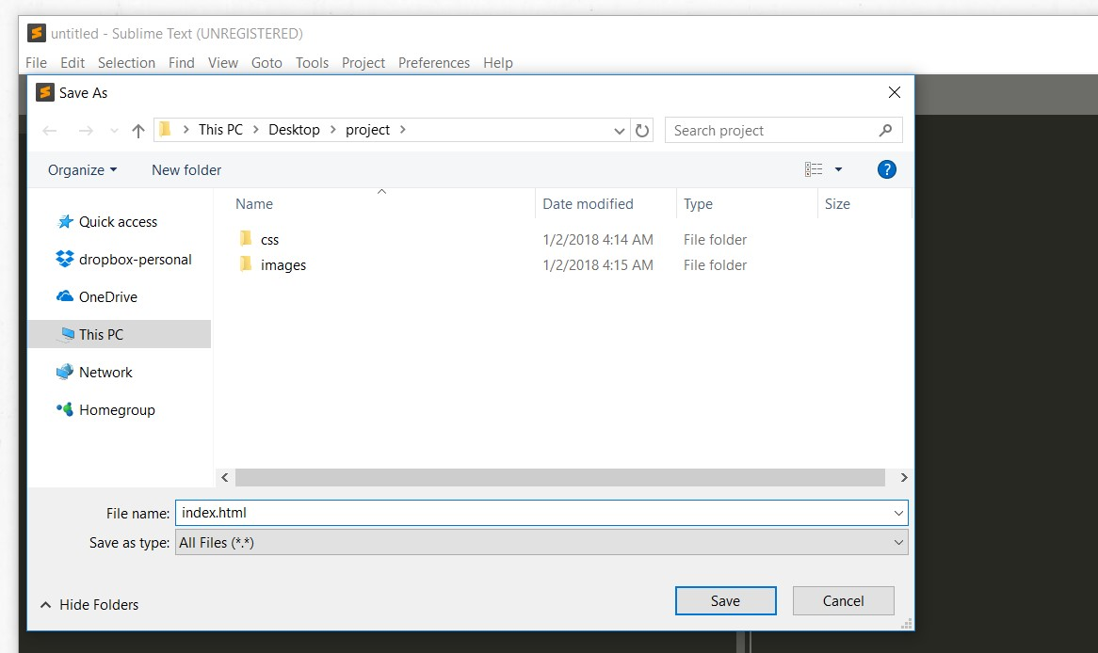
Save file as index.html.

Slide 5
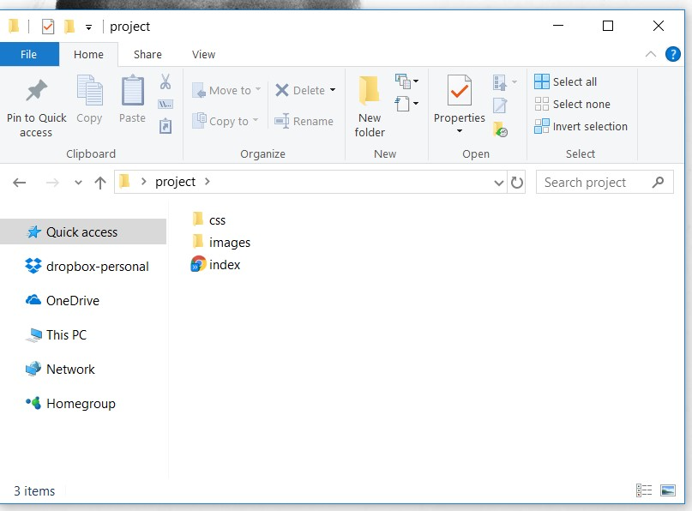

Slide 6
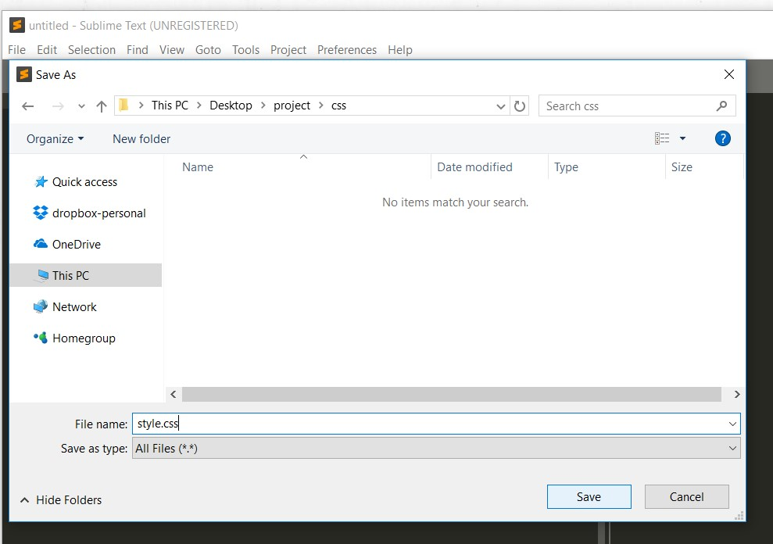
Click on New File again and save file as style.css under the css subfolder.

Slide 7
